Slide 1
Snake 2.o
An improved desktop version of the classical Snake game
Andy Hameed | Usman Irfan | Vaibhav Chadha
VUA 30
Group 30
Notes:
Visuals should be used moderately throughout the slides - 1 per slide is fine
*** Open new

Slide 2
Topics
Introduction
Purpose, background & scope
Functionality
Discussion
Game demo
Difficulties
Peer verification and validation
Conclusion
Original vs. new implementation
Future improvements
Q & A
Notes:
V

Slide 3
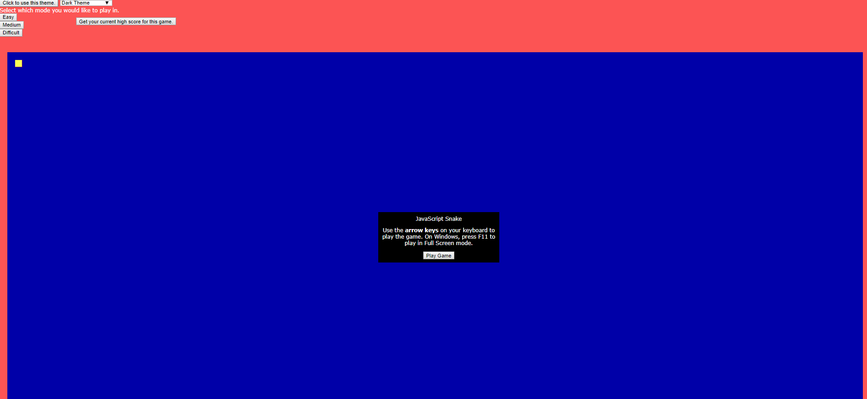
Purpose, Background & Scope
Purpose & Background
Classical snake game
Interface and overall look
Desktop version vs. online version
Theme options
Scope
Reimplement with original requirements
Implement new theme options
Organize design and layout
Original Project:
Javascript-Snake by patorjk
Notes:
V
Around 1 - 2 mins
Desktop vs. online
Online version requires internet access and accessing third-party websites to play the game
Interface and overall look
Original project was lacking in layout and design among other aspects

Slide 4
Functionality
The game requires the user to request all inputs from mouse and keyboards.
The game has a High Score button that displays the user’s highest score they have played so far.
The game offers a help menu to guide new users.
Have 3 different modes: easy, intermediate and advanced.
Optioning the user to select different themes
Added maze in advanced to add more difficulty .
More requirements will be explained in the demo.
Original Project:
Javascript-Snake by patorjk
Notes:
U
***Put up low coupling, high cohesion
Maintainability
portability
Around 1 - 2 mins
Desktop vs. online
Online version requires internet access and accessing third-party websites to play the game
Interface and overall look
Original project was lacking in layout and design among other aspects

Slide 5
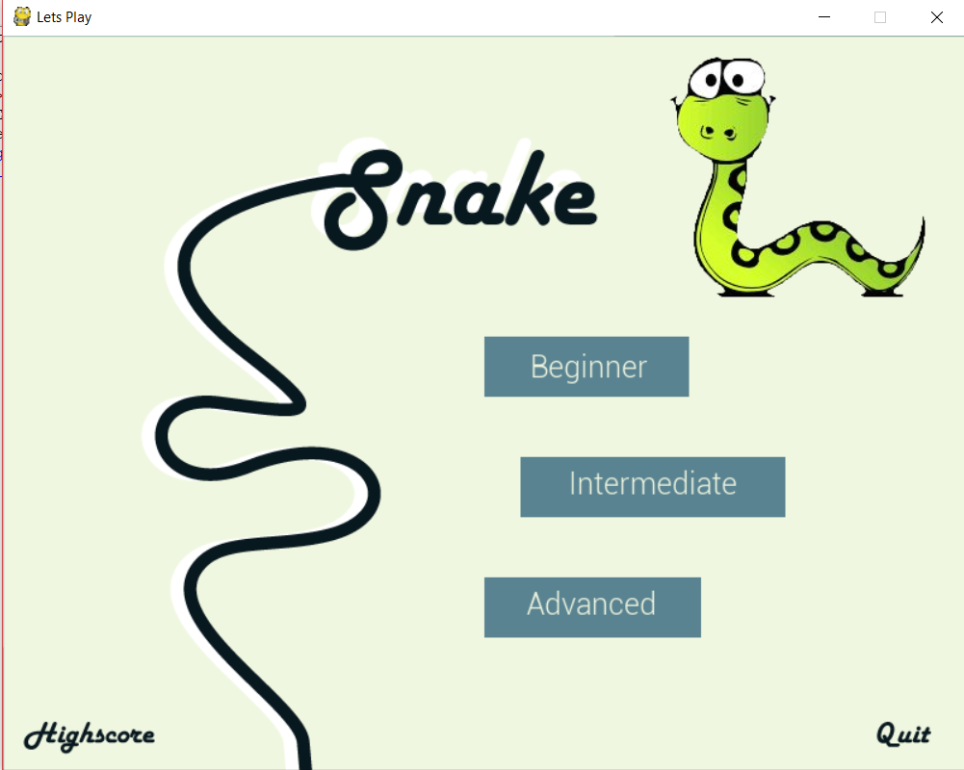
Game Demo
Notes:
A & V
A demos
V narrates
** Have the game open and running

Slide 6
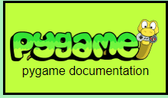
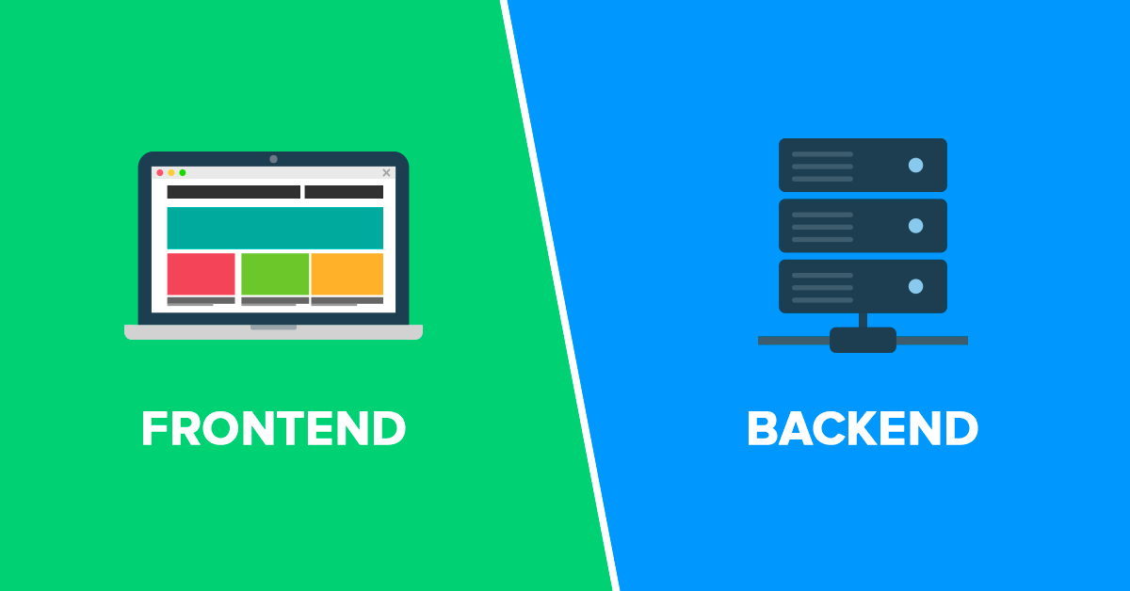
Difficulties
Documentation for pygame
Connecting interface and implementation
Switching to Object-Oriented approach halfway through process
Notes:
A

Slide 7

Peer Verification & Validation
Surveyed peers on the game using google forms
Continuously tested the game throughout development process
Notes:
A

Slide 8
Original vs. new implementation
Original Project:
Javascript-Snake by patorjk
3XA3 Project:
Reimplementation of Snake
Notes:
A
Add video demoing each game

Slide 9
Any Questions?
Notes:
V

Slide 10
Thank you!
Group 30 | VUA30 | L03
Vaibhav Chadha
Andy Hameed
Usman Irfan

Slide 11


Future Improvements
More themes
New modes - flashlight mode, multiplayer mode
Better graphics - snake will appear more animated
Notes:
U

Slide 12
Discussion
Topics that will be discussed:
Project Management
Peer testing and verifying snake game
Qualities of the game (functions and features)
Discuss one non functional quality like robustness, user-friendliness, maintainability, etc.
Discuss another quality of the system
Show previous (original implementation) vs. current implementation in slides

